Slide 1

计算机组成与系统结构 Computer Organization & System Architecture
Huang Kejie (黄科杰) 百人计划研究员
Office: 玉泉校区老生仪楼304
Email address: huangkejie@zju.edu.cn
HP: 17706443800

Slide 2
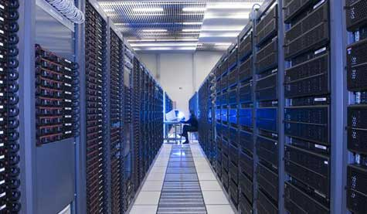

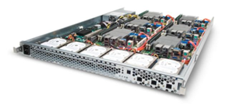
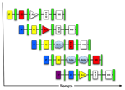
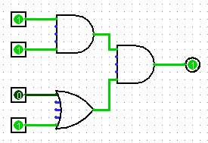
New-School Machine Structures
Parallel Requests
Assigned to computer
e.g., Search “Katz”
Parallel Threads
Assigned to core
e.g., Lookup, Ads
Parallel Instructions
>1 instruction @ one time
e.g., 5 pipelined instructions
Parallel Data
>1 data item @ one time
e.g., Add of 4 pairs of words
Hardware descriptions
All gates @ one time
Programming Languages
Software Hardware
Warehouse Scale Computer
Smart Phone
Harness Parallelism &
Achieve High Performance
Computer
Core
…
Core
Memory (Cache)
Input/Output
Core
Instruction Unit(s)
Functional
Unit(s)
A₀+B₀
A₁+B₁
A₂+B₂
A₃+B₃
Cache Memory
Logic Gates

Slide 3
Review: Single-Cycle RISC-V RV32I Datapath

Slide 4
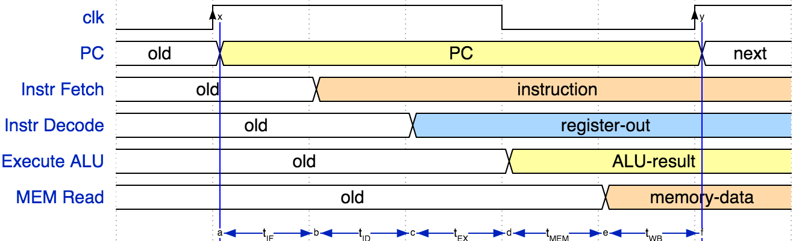
Review: Single Cycle Instruction Timing
IF | ID | EX | MEM | WB | Total
I-MEM | Reg Read | ALU | D-MEM | Reg W
200 ps | 100 ps | 200 ps | 200 ps | 100 ps | 800 ps

Slide 5
Review: Pipelining RISC-V RV32I Datapath
Instruction Decode/Register Read
(D)
Write
Back
(W)
Instruction Fetch
(F)
ALU Execute
(X)
Memory Access
(M)

Slide 6
Components of a Computer
Processor
Memory
Input
Enable?
Read/Write
Control
Program
Datapath
Address
Bytes
PC
Registers
Write Data
Data
Arithmetic & Logic Unit
(ALU)
ReadData
Output
Processor-Memory Interface
I/O-Memory Interfaces

Slide 7
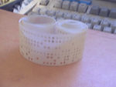
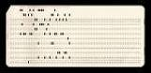
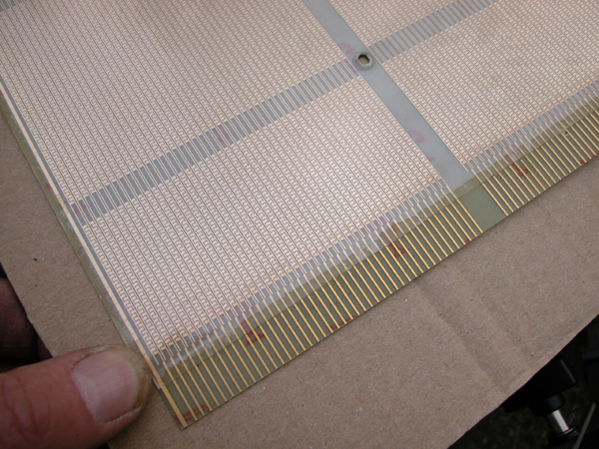
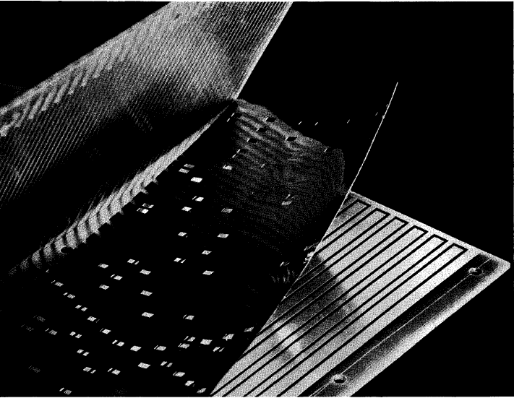
Early Read-Only Memory Technologies
Punched cards, From early 1700s through Jaquard Loom, Babbage, and then IBM
Punched paper tape, instruction stream in Harvard Mk 1
Diode Matrix, EDSAC-2 µcode store
IBM Balanced Capacitor ROS
IBM Card Capacitor ROS

Slide 8
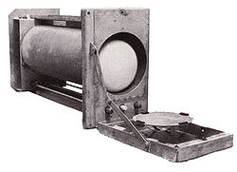
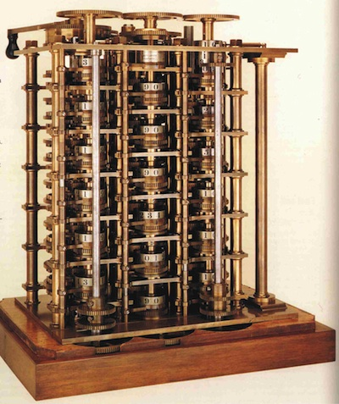
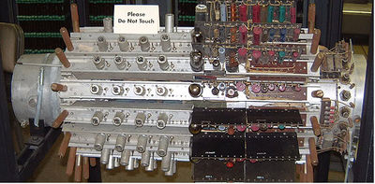
Early Read/Write Main Memory Technologies
Babbage, 1800s: Digits stored on mechanical wheels
Williams Tube, Manchester Mark 1, 1947
Mercury Delay Line, Univac 1, 1951
Also, regenerative capacitor memory on Atanasoff-Berry computer, and rotating magnetic drum memory on IBM 650

Slide 9
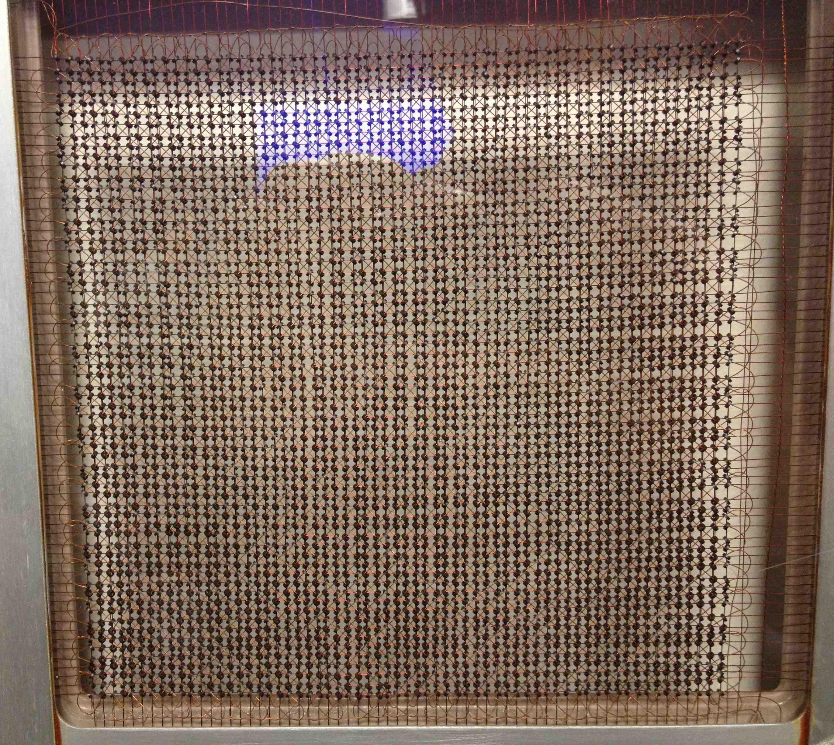
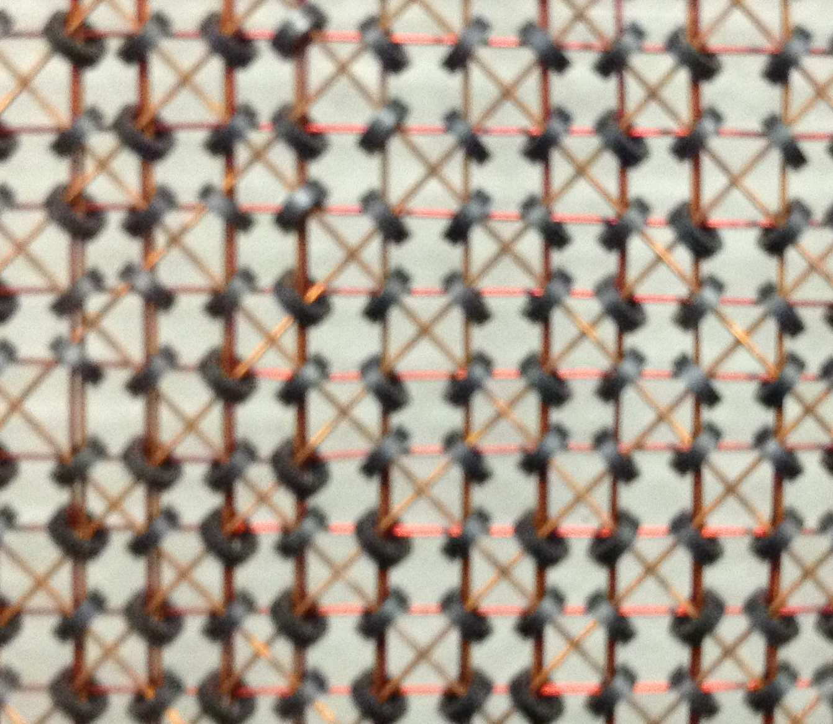
MIT Whirlwind Core Memory

Slide 10
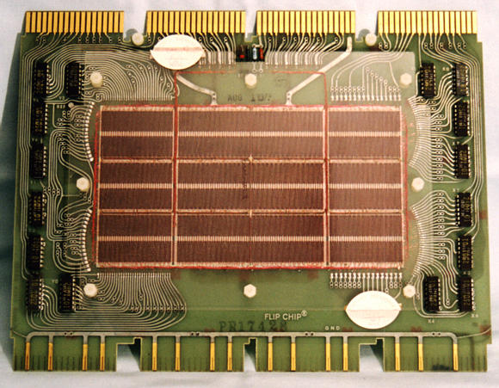
Core Memory
Core memory was first large scale reliable main memory
invented by Forrester in late 40s/early 50s at MIT for Whirlwind project
Bits stored as magnetization polarity on small ferrite cores threaded onto two-dimensional grid of wires
Coincident current pulses on X and Y wires would write cell and also sense original state (destructive reads)
Robust, non-volatile storage
Used on space shuttle computers
Cores threaded onto wires by hand (25 billion a year at peak production)
Core access time ~ 1µs
DEC PDP-8/E Board,
4K words x 12 bits, (1968)

Slide 11
Core Memory
Semiconductor memory began to be competitive in early 1970s
Intel formed to exploit market for semiconductor memory
Early semiconductor memory was Static RAM (SRAM). SRAM cell internals similar to a latch (cross-coupled inverters).
First commercial Dynamic RAM (DRAM) was Intel 1103
1Kbit of storage on single chip
charge on a capacitor used to hold value
Semiconductor memory quickly
replaced core in ‘70s

Slide 12
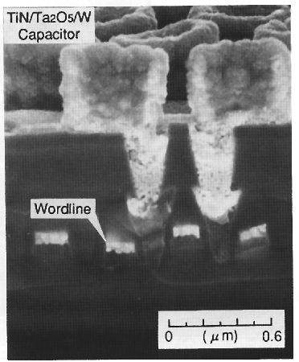
One-Transistor Dynamic RAM [Dennard, IBM]
1-T DRAM Cell
word
access transistor
TiN top electrode (V_{REF})
V_{REF}
Ta₂O₅ dielectric
bit
Storage
capacitor (FET gate, trench, stack)
poly
word
line
W bottom
electrode
access transistor

Slide 13
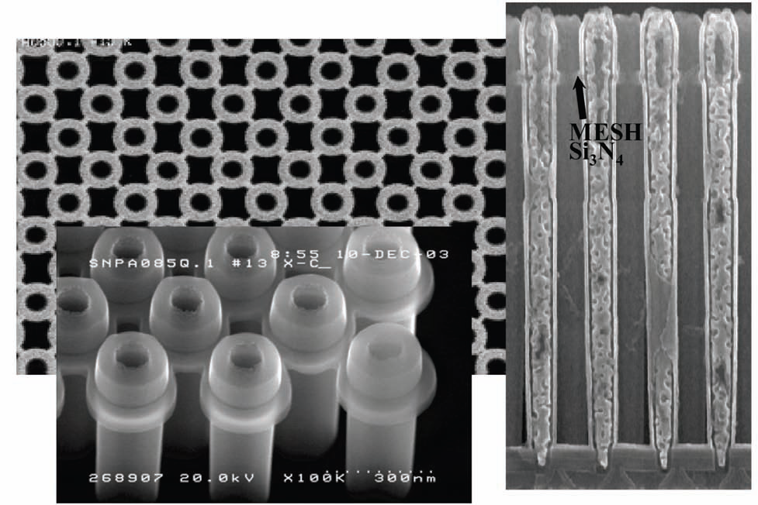
Modern DRAM Structure
[Samsung, sub-70nm DRAM, 2004]

Slide 14
DRAM Architecture
bit lines
Col.
1
Col. 2^{M}
word lines
Row 1
N
Row Address Decoder
Row 2^{N}
Memory cell (one bit)
M
Column Decoder & Sense Amplifiers
N+M
Data
D
Bits stored in 2-dimensional arrays on chip
Modern chips have around 4-8 logical banks on each chip
each logical bank physically implemented as many smaller arrays

Slide 15
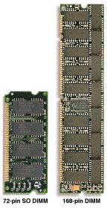
DRAM Architecture
~7
Clock and control signals
DRAM chip
Address lines multiplexed row/column address
~12
Data bus
(4b,8b,16b,32b)
DIMM (Dual Inline Memory Module) contains multiple chips with clock/control/address signals connected in parallel (sometimes need buffers to drive signals to all chips)
Data pins work together to return wide word (e.g., 64-bit data bus using 16x4-bit parts)

Slide 16
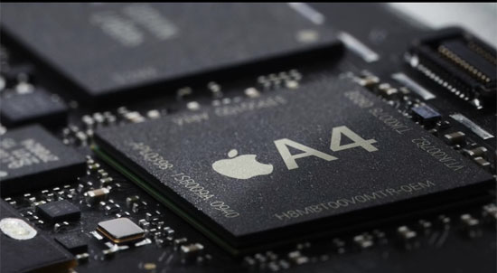
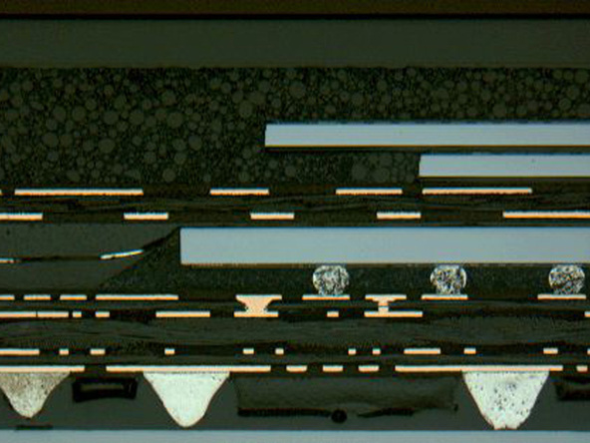
DRAM Packaging, Mobile Devices
[ Apple A4 package on circuit board]
Two stacked DRAM die
Processor plus logic die
[ Apple A4 package cross-section, iFixit 2010 ]

Slide 17
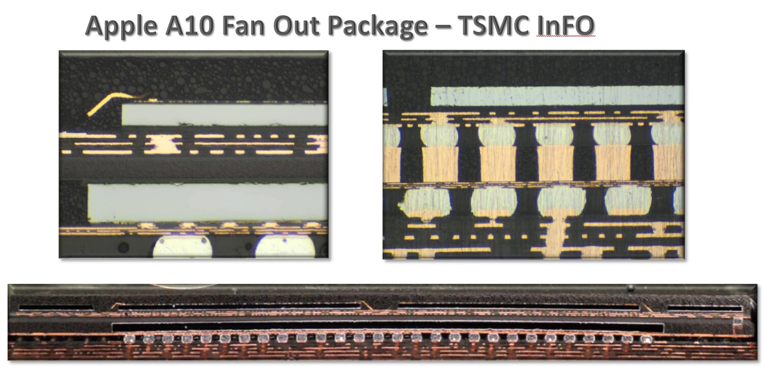
DRAM Packaging Apple A10

Slide 18
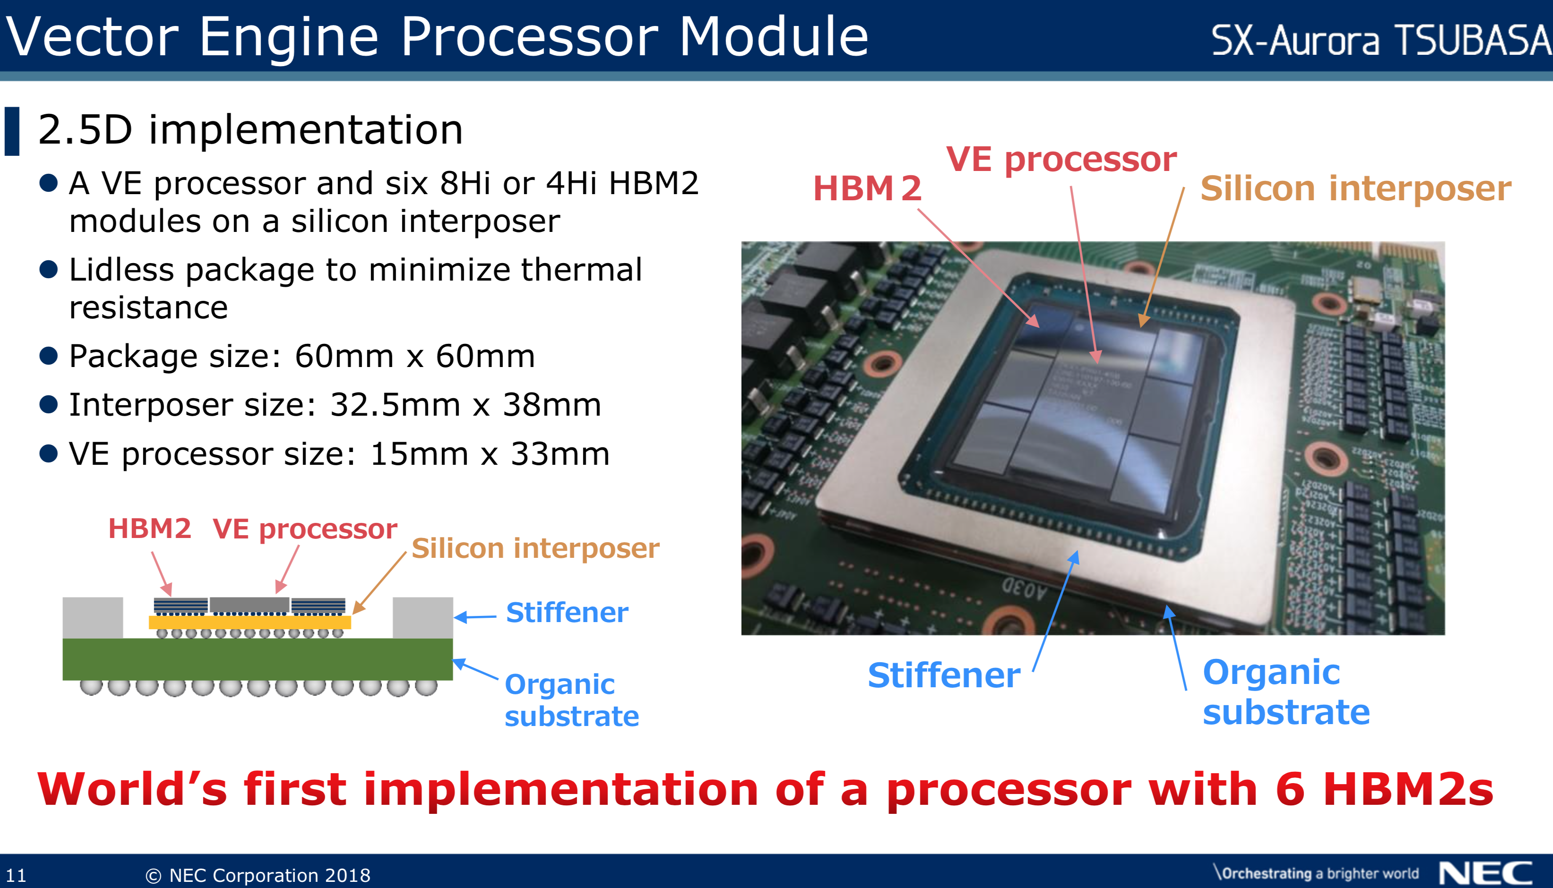
High-Bandwidth Memory in SX-Aurora
1.2TB/s HBM Bandwidth, 6 channels * 1024 bits/channel * 1.6 Gb/s/pin

Slide 19
DRAM Operation
Three steps in read/write access to a given bank
Row access (RAS)
decode row address, enable addressed row (often multiple Kb in row)
bitlines share charge with storage cell
small change in voltage detected by SAs which latch whole row of bits
sense amplifiers drive bitlines full rail to recharge storage cells
Column access (CAS)
decode column address to select small number of sense amplifier latches (4, 8, 16, or 32 bits depending on DRAM package)
on read, send latched bits out to chip pins
on write, change SA latches which then charge storage cells to required value
can perform multiple column accesses on same row without another row access (burst mode)
Precharge
charges bit lines to known value, required before next row access
Each step has a latency of around 15-20ns in modern DRAMs
Various DRAM standards (DDR, RDRAM) have different ways of encoding the signals for transmission to the DRAM, but all share same core architecture

Slide 20
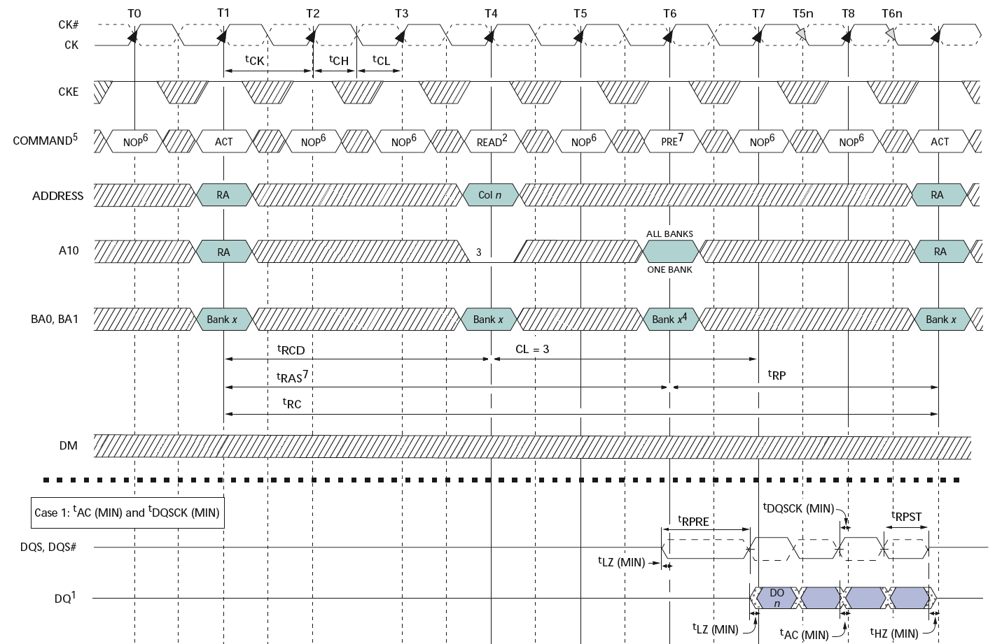
Double-Data Rate (DDR2) DRAM
200MHz Clock
Column
Precharge
Row’
Row
Data
400Mb/s Data Rate
[ Micron, 256Mb DDR2 SDRAM datasheet ]

Slide 21
CPU-Memory Bottleneck
Memory
CPU
Performance of high-speed computers is usually limited by memory bandwidth & latency
Latency (time for a single access)
Memory access time >> Processor cycle time
Bandwidth (number of accesses per unit time)
if fraction m of instructions access memory
1+m memory references / instruction
CPI = 1 requires 1+m memory refs / cycle (assuming RISC-V ISA)

Slide 22
Physical Size Affects Latency
CPU
CPU
Big Memory
Small Memory
Signals have further to travel
Fan out to more locations

Slide 23
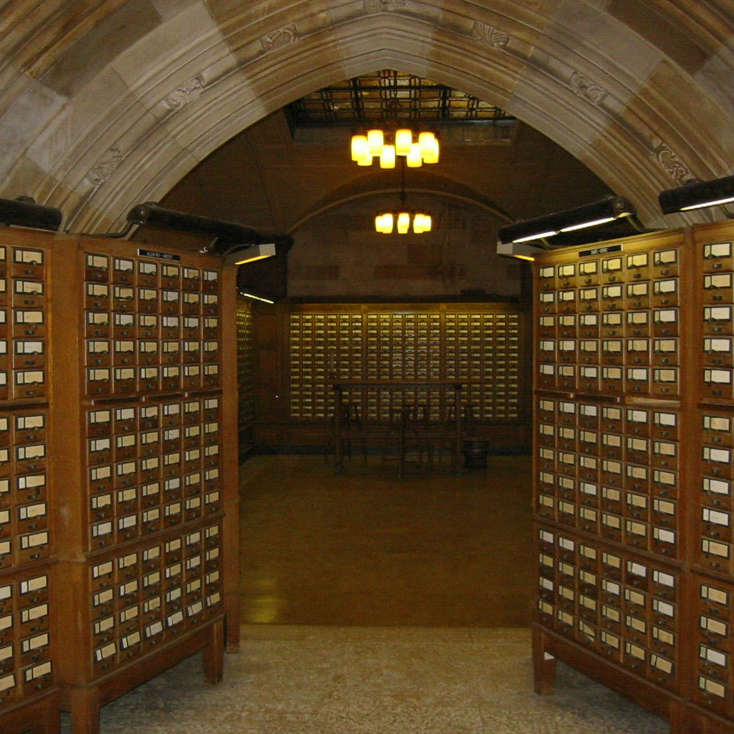

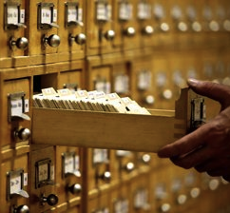
Why are Large Memories Slow? Library Analogy
Time to find a book in a large library
Search a large card catalog – (mapping title/author to index number)
Round-trip time to walk to the stacks and retrieve the desired book
Larger libraries worsen both delays
Electronic memories have same issue, plus the technologies used to store a bit slow down as density increases (e.g., SRAM vs. DRAM vs. Disk)
However what we want is a large yet fast memory!

Slide 24

What To Do: Library Analogy
Write a report using library books
E.g., works of J.D. Salinger
Go to library, look up relevant books, fetch from stacks, and place on desk in library
If need more, check them out and keep on desk
But don’t return earlier books since might need them
You hope this collection of ~10 books on desk enough to write report, despite 10 being only 0.00001% of books in ZJU libraries

Slide 25
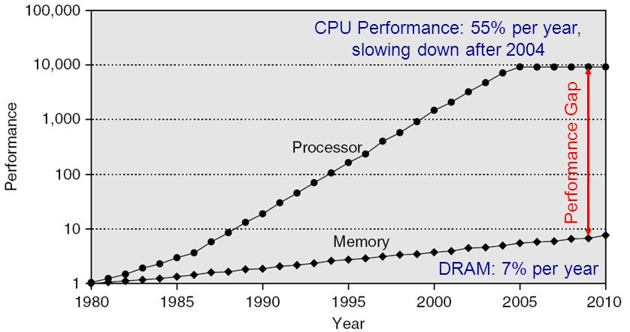
Processor-DRAM Gap (Latency)
1980 microprocessor executes ~one instruction in same time as DRAM access
2017 microprocessor executes ~1000 instructions in same time as DRAM access
Slow DRAM access has disastrous impact on CPU performance!

Slide 26
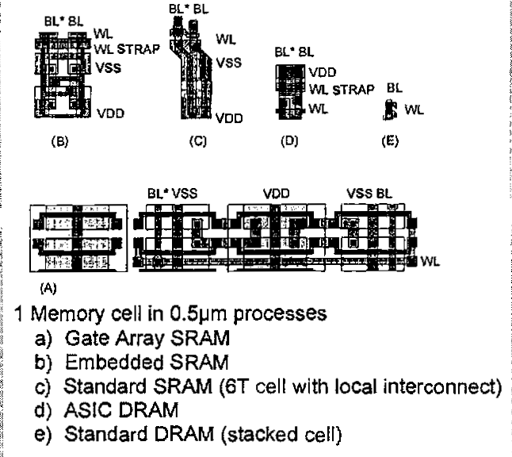
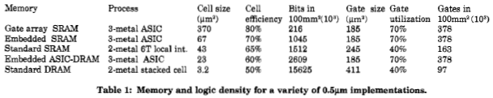
Relative Memory Cell Sizes
On-Chip SRAM in logic chip
DRAM on memory chip
[ Foss, “Implementing Application-Specific Memory”, ISSCC 1996 ]

Slide 27
Big Idea: Memory Hierarchy
Processor
Inner
Increasing distance from processor, decreasing speed
Levels in memory hierarchy
Level 1
Level 2
Level 3
Outer
. . .
Level n
Size of memory at each level
As we move to outer levels the latency goes up and price per bit goes down. Why?

Slide 28
Typical Memory Hierarchy
On-Chip Components
Control
Third-Level
Cache
(SRAM)
Instr
Cache
Second-Level
Cache
(SRAM)
Main
Memory
(DRAM)
Secondary
Memory
(Disk
Or Flash)
Datapath
RegFile
Data
Cache
Speed (cycles): ½’s 1’s 10’s 100’s-1000 1,000,000’s
Size (bytes): 100’s 10K’s M’s G’s T’s
Cost/bit: highest lowest
Principle of locality + memory hierarchy presents programmer with ≈ as much memory as is available in the cheapest technology at the ≈ speed offered by the fastest technology

Slide 29
Memory Hierarchy
Big, Slow Memory
(DRAM)
A
Small,
Fast Memory
(RF, SRAM)
B
CPU
holds frequently used data
capacity: Register << SRAM << DRAM
latency: Register << SRAM << DRAM
bandwidth: on-chip >> off-chip
On a data access:
if data ∈ fast memory ⇒ low latency access (SRAM)
if data ∉ fast memory ⇒ high latency access (DRAM)

Slide 30
Management of Memory Hierarchy
Small/fast storage, e.g., registers
Address usually specified in instruction
Generally implemented directly as a register file
but hardware might do things behind software’s back, e.g., stack management, register renaming
Larger/slower storage, e.g., main memory
Address usually computed from values in register
Generally implemented as a hardware-managed cache hierarchy (hardware decides what is kept in fast memory)
but software may provide “hints”, e.g., don’t cache or prefetch

Slide 31
Big Idea: Locality
Temporal Locality (locality in time)
Go back to same book on desk multiple times
If a memory location is referenced, then it will tend to be referenced again soon
Spatial Locality (locality in space)
When go to book shelf, pick up multiple books on J.D. Salinger since library stores related books together
If a memory location is referenced, the locations with nearby addresses will tend to be referenced soon

Slide 32
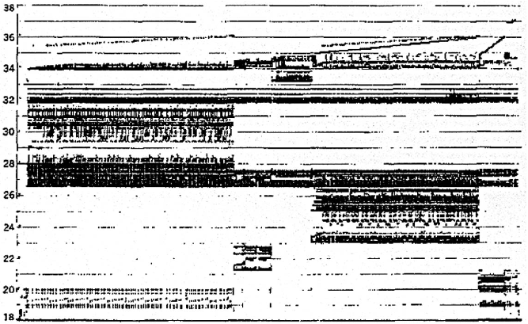
Memory Reference Patterns
Temporal
Locality
Memory Address (one dot per access)
Spatial
Locality
Time
Donald J. Hatfield, Jeanette Gerald: Program Restructuring for Virtual Memory. IBM Systems Journal 10(3): 168-192 (1971)

Slide 33
Principle of Locality
Principle of Locality: Programs access small portion of address space at any instant of time (spatial locality) and repeatedly access that portion (temporal locality)
What program structures lead to temporal and spatial locality in instruction accesses?
In data accesses?
What structures defeat temporal and spatial locality in instruction and data accesses?

Slide 34
Memory Reference Patterns
Address
n loop iterations
Instruction
fetches
subroutine call
subroutine return
Stack
accesses
argument access
Data
accesses
vector access
scalar accesses
Time

Slide 35
Caches exploit both types of predictability:
Exploit temporal locality by remembering the contents of recently accessed locations.
Keep recently referenced items at higher levels, future references satisfied quickly
Exploit spatial locality by fetching blocks of data around recently accessed locations.
Bring neighbors of recently referenced to higher levels, future references satisfied quickly

Slide 36
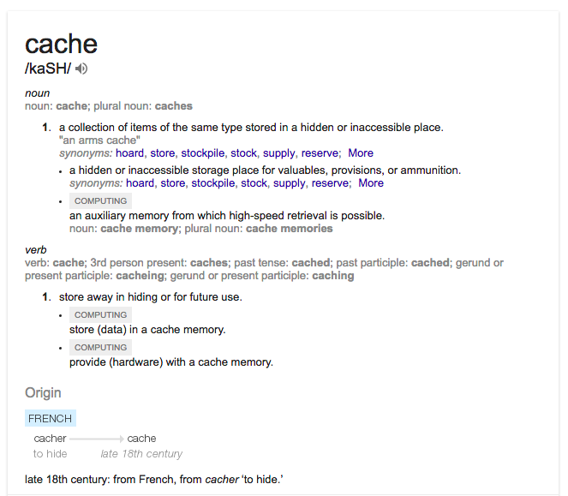
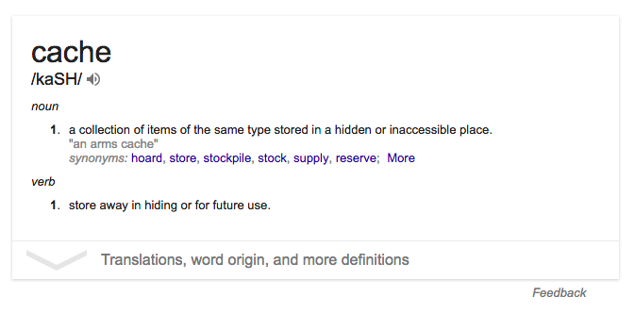
Cache

Slide 37
Cache Philosophy
Programmer-invisible hardware mechanism gives illusion of speed of fastest memory with size of largest memory
Works even if you have no idea what a cache is
Performance-oriented programmers sometimes “reverse engineer” cache organization to design data structures and access patterns optimized for a specific cache design

Slide 38
Memory Access without Cache
Load word instruction: lw t0,0(t1)
t1 contains 1022_{ten}, Memory[1022] = 99
Processor issues address 1022_{ten} to Memory
Memory reads word at address 1022_{ten} (99)
Memory sends 99 to Processor
Processor loads 99 into register t0

Slide 39
Adding Cache to Computer
Processor
Memory
Input
Enable?
Read/Write
Control
Program
Memory (including
cache) organized around blocks, which are typically multiple words
Datapath
Address
Bytes
PC
Cache
Registers
Write Data
Data
Arithmetic & Logic Unit
(ALU)
Read Data
Output
Processor organized around words and bytes
Processor-Memory Interface
I/O-Memory Interfaces

Slide 40
Memory Access with Cache
Load word instruction: lw t0,0(t1)
t1 contains 1022_{ten}, Memory[1022] = 99
With cache: Processor issues address 1022_{ten} to Cache
Cache checks to see if has copy of data at address 1022_{ten}
If finds a match (Hit): cache reads 99, sends to processor
No match (Miss): cache sends address 1022 to Memory
Memory reads 99 at address 1022_{ten}
Memory sends 99 to Cache
Cache replaces word with new 99
Cache sends 99 to processor
Processor loads 99 into register t0

Slide 41
Inside a Cache
Address
Address
Processor
CACHE
Main
Memory
Data
Data
copy of main
memory
location 100
copy of main
memory
location 101
100
Data
Byte
Data
Byte
Line
304
Data
Byte
Address
Tag
6848
416
Data Block

Slide 42
Cache Algorithm (Read)
Look at Processor Address, search cache tags to find match. Then either
Found in cache
a.k.a. HIT
Not in cache
a.k.a. MISS
Return copy
of data from
cache
Read block of data from
Main Memory
Wait …
Return data to processor
and update cache
Q: Which line do we replace?

Slide 43
Cache “Tags”
Need way to tell if have copy of location in memory so that can decide on hit or miss
On cache miss, put memory address of block in “tag address” of cache block
1022 placed in tag next to data from memory (99)
Tag | Data
252 | 12
1022 | 99
131 | 7
2041 | 20
From earlier
loads or stores

Slide 44
Anatomy of a 16 Byte Cache, with 4 Byte Blocks
Operations:
Cache Hit
Cache Miss
Refill cache from memory
Cache needs Address Tags to decide if Processor Address is a Cache Hit or Cache Miss
Compares all four tags
Processor
32-bit
Address
32-bit
Data
252
12
1022
99
131
7
2041
20
Cache
32-bit
Address
32-bit
Data
Memory
44

Slide 45
Cache Replacement
Suppose processor now requests location 511, which contains 11?
Doesn’t match any cache block, so must “evict” a resident block to make room
Which block to evict?
Replace “victim” with new memory block at address 511
Tag | Data
252 | 12
1022 | 99
131 | 7
2041 | 20
least_recently used(LRU)

Slide 46
Block Must be Aligned in Memory
Word blocks are aligned, so binary address of all words in cache always ends in 00_{two}
How to take advantage of this to save hardware and energy?
Don’t need to compare last 2 bits of 32-bit byte address (comparator can be narrower)
Don’t need to store last 2 bits of 32-bit byte address in Cache Tag (Tag can be narrower)

Slide 47
Anatomy of a 32B Cache, 8B Blocks
Blocks must be aligned in pairs, otherwise could get same word twice in cache
Tags only have even-numbered words
Last 3 bits of address always 000_{two}
Tags, comparators can be narrower
Can get hit for either word in block
Processor
32-bit
Address
32-bit
Data
252
12
-10
1022
99
1000
130
42
7
2040
1947
20
Cache
32-bit
Address
32-bit
Data
Memory

Slide 48
Hardware Cost of Cache
Need to compare every tag to the Processor address
Comparators are expensive
Optimization: use two “sets” of data with a total of only 2 comparators
Use one Address bit to select which set
Compare only tags from selected set
Generalize to more sets
Processor
32-bit
Address
32-bit
Data
Set 0
Tag
Data
Tag
Data
Set 1
Tag
Data
Tag
Data
Cache
32-bit
Address
32-bit
Data
Memory

Slide 49
Hardware Cost of Cache
Processor
32-bit
Address
32-bit
Data
Tag
Compare
Set 0
252
12
Even
Word
1022
99
Set 1
131
7
Odd
Word
Set Index
2041
20
31 3
2 1 0
Cache
00
32-bit
Address
32-bit
Data
Byte in word (block)
Memory

